Slide 1
TCS Stock Price Analysis & Prediction Using Machine Learning
Tools: Python (Pandas, Scikit-learn), Power BI, DAX
Blesson Biju
UMID – UMID27112571779
Dec 1st Batch

Slide 2
Problem Statement
Stock price prediction helps investors make informed decisions.
Historical stock data can be analyzed to forecast future price trends.
Objective:
Analyze historical TCS stock data.
Build a machine learning model to predict closing prices.
Create a Power BI dashboard for trend visualization.

Slide 3
Dataset Description
Historical stock data (Date, Open, High, Low, Close, Volume)
Time period covered
Number of records
Data cleaning performed
Date converted to datetime
Feature engineering

Slide 4
Exploratory Data Analysis (EDA)
Closing price trend over time
Volume trend
High vs Low comparison
Long-term upward/downward trend
Volatility patterns
High trading volume periods

Slide 5
Data Preprocessing & Feature Engineering
Train-test split
Scaling (if applied)
Feature selection
Time-series considerations

Slide 6
Model Building
Algorithm used (Linear Regression / Random Forest / etc.)
Training approach
The model captures general trend but may struggle with sudden volatility.

Slide 7
Interactive Stock Dashboard
Closing price trend
Volume analysis
Year-wise performance
Filters by date
Investors can identify peak periods, trend reversals, and volume spikes.

Slide 8
Conclusion
Key Findings:
TCS shows long-term growth trend
Volume correlates with volatility
ML model predicts general movement
Limitations:
Market sentiment not included
External economic factors ignored
Future Scope:
LSTM for time-series forecasting
Incorporate news sentiment analysis
Real-time prediction deployment

Slide 9
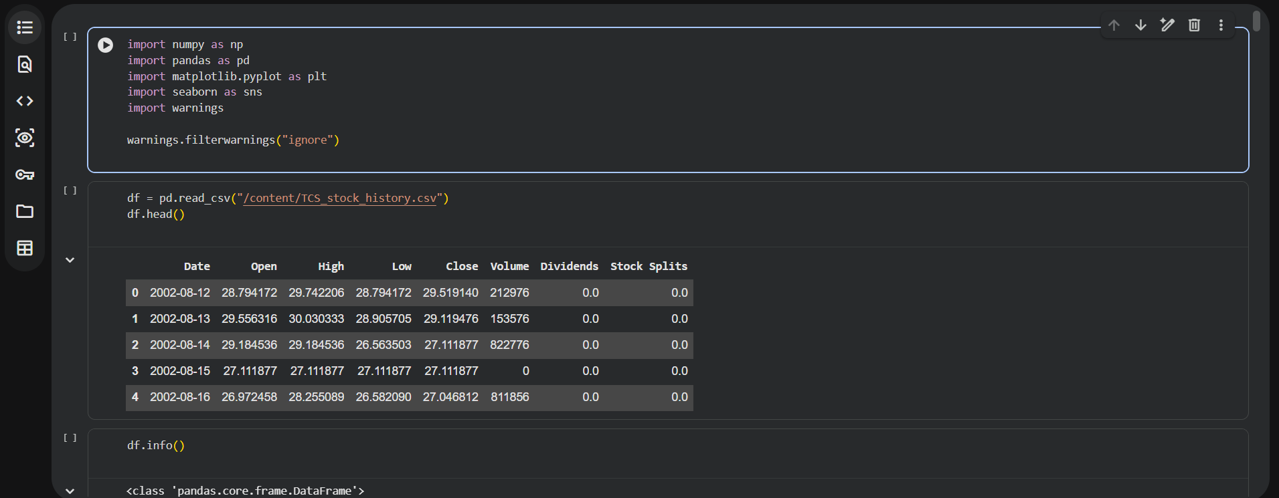
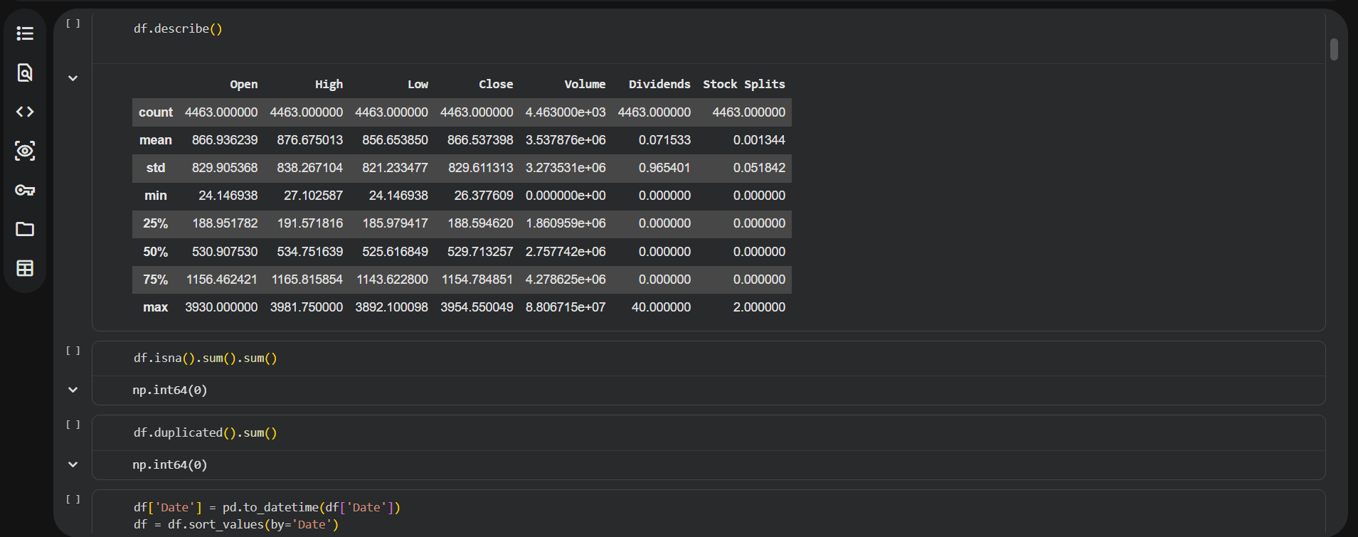

Slide 10
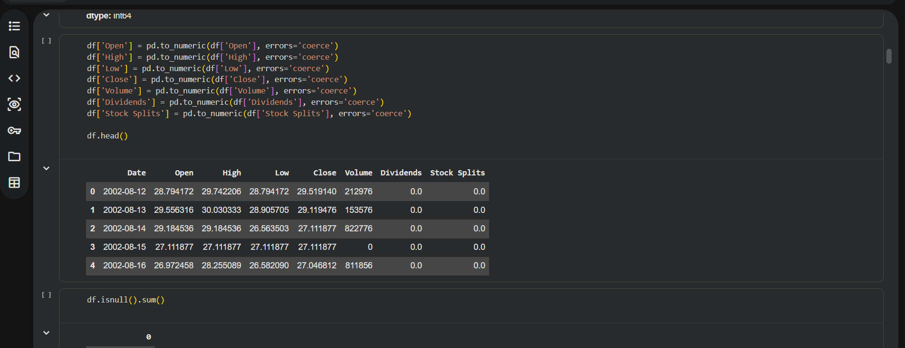
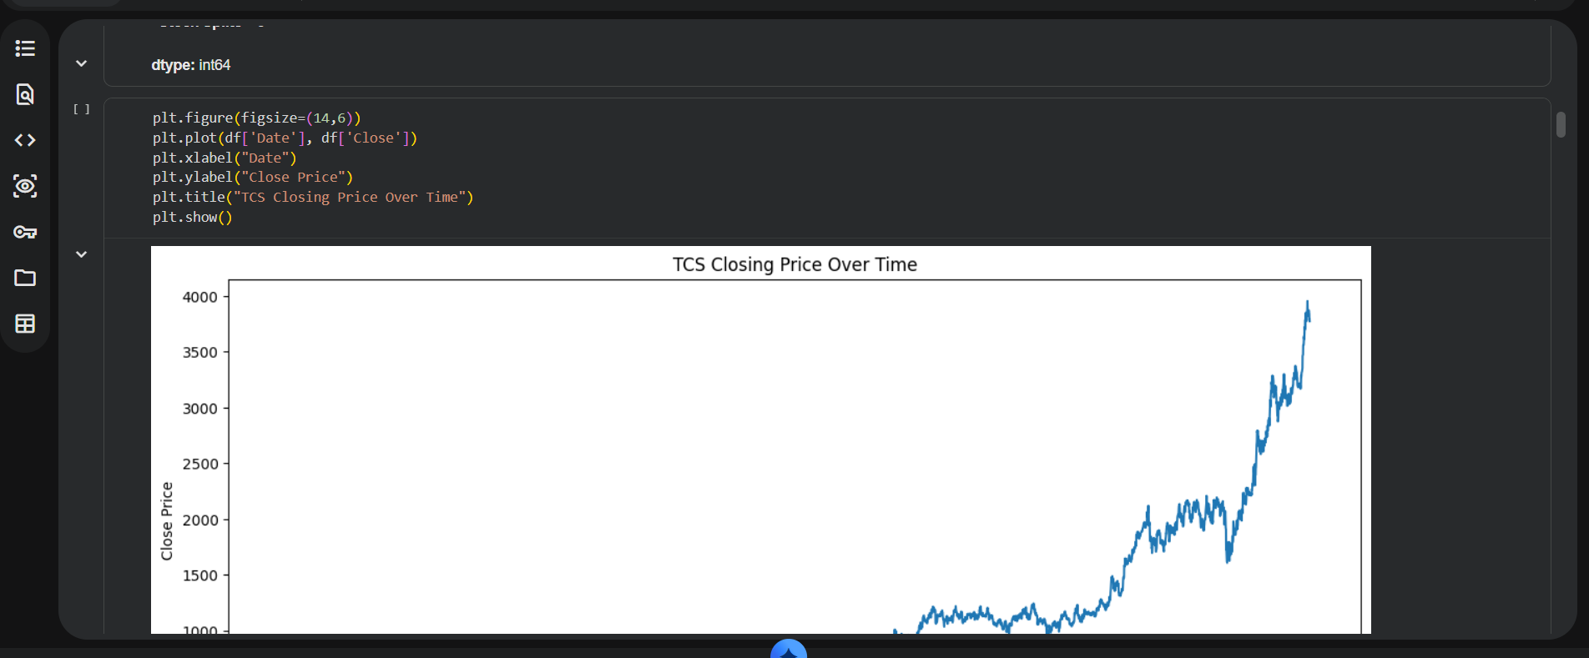

Slide 11
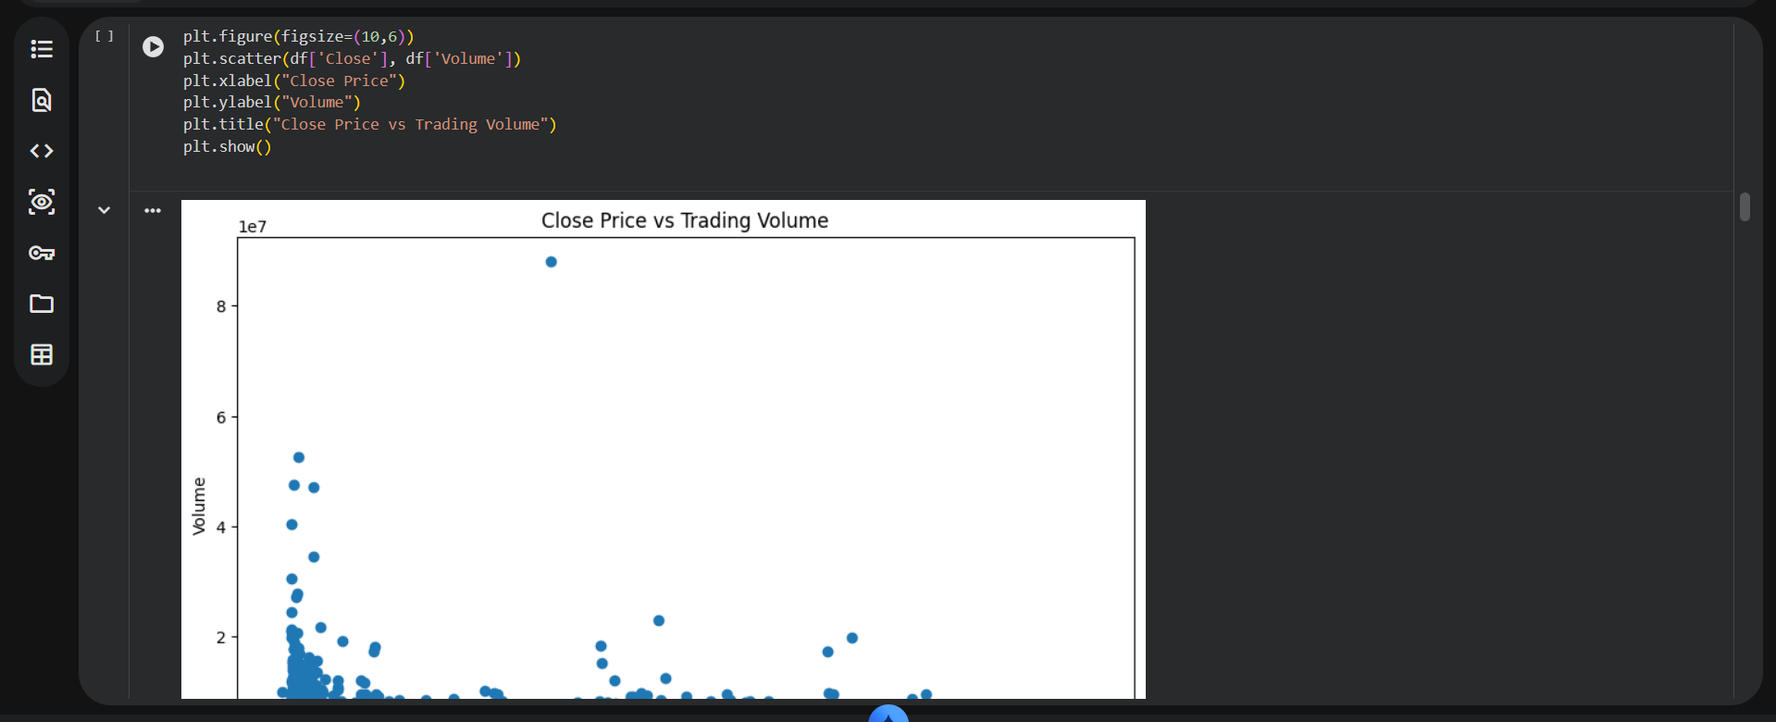
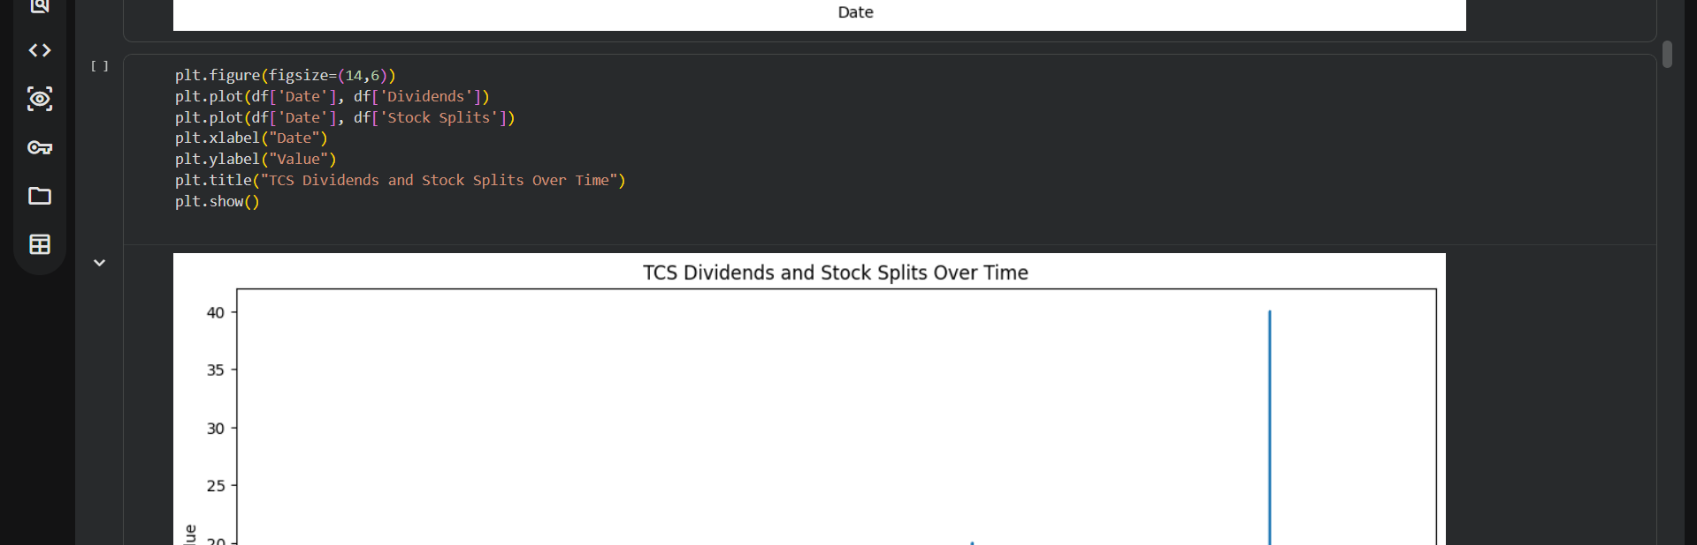

Slide 12
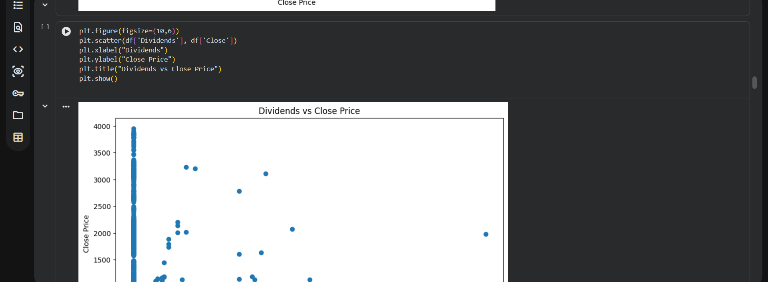
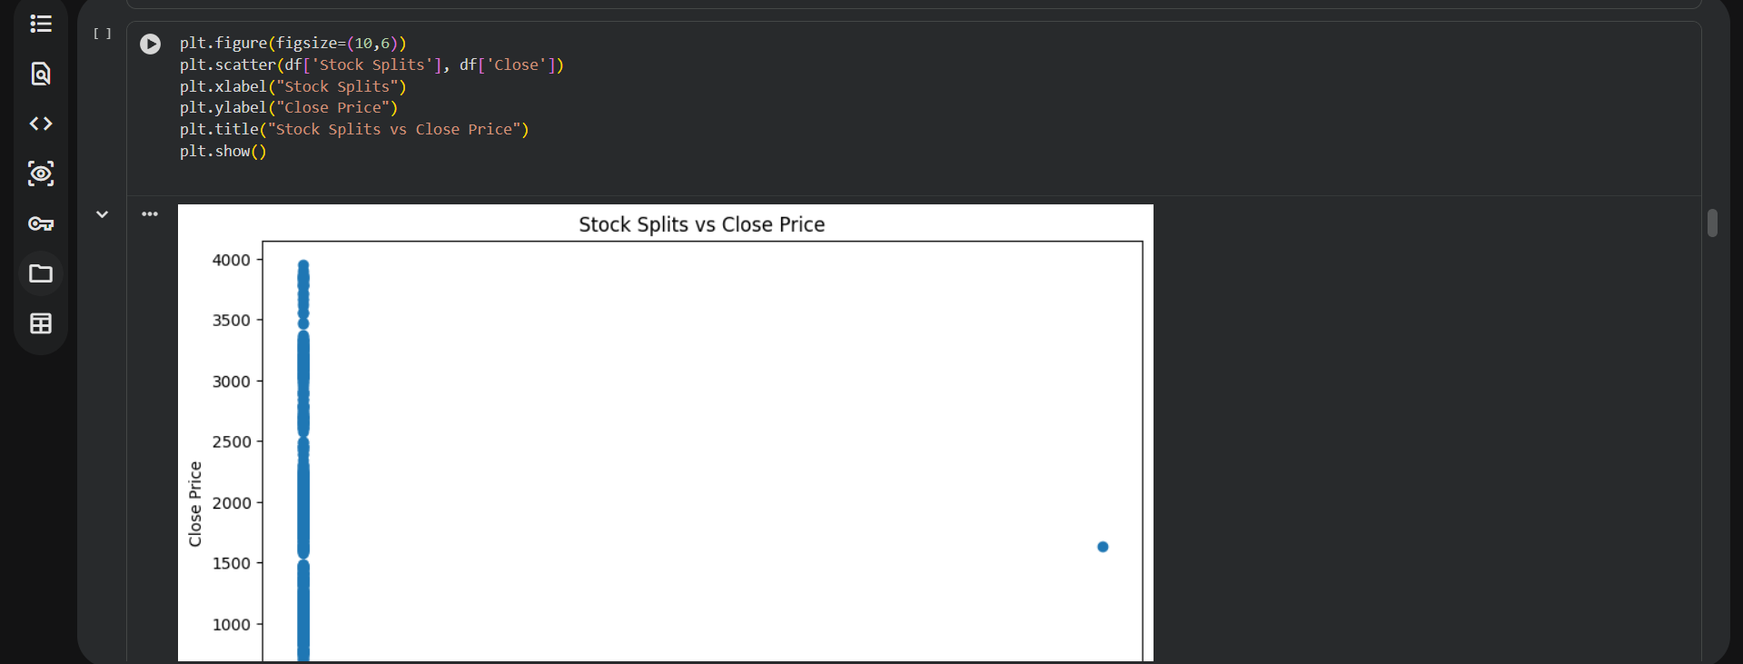
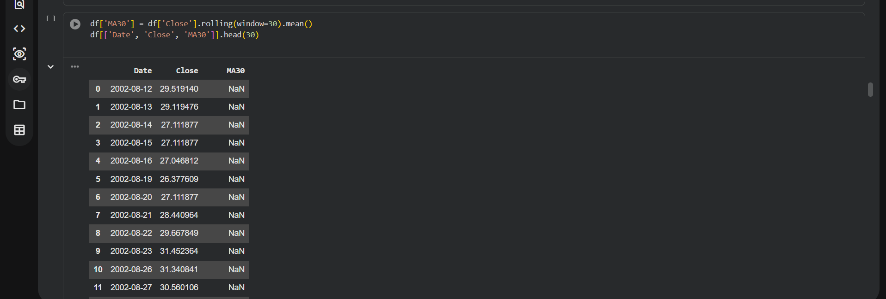

Slide 13
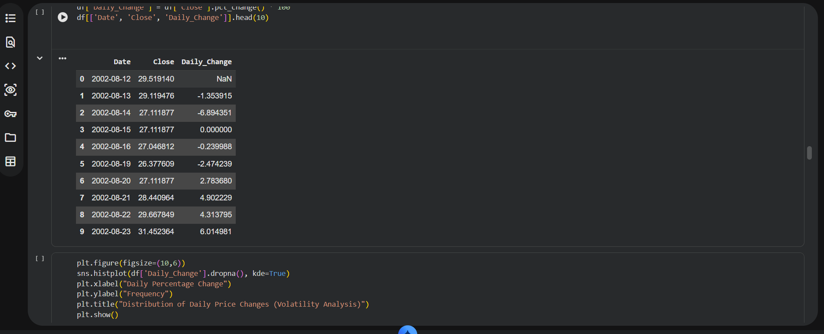
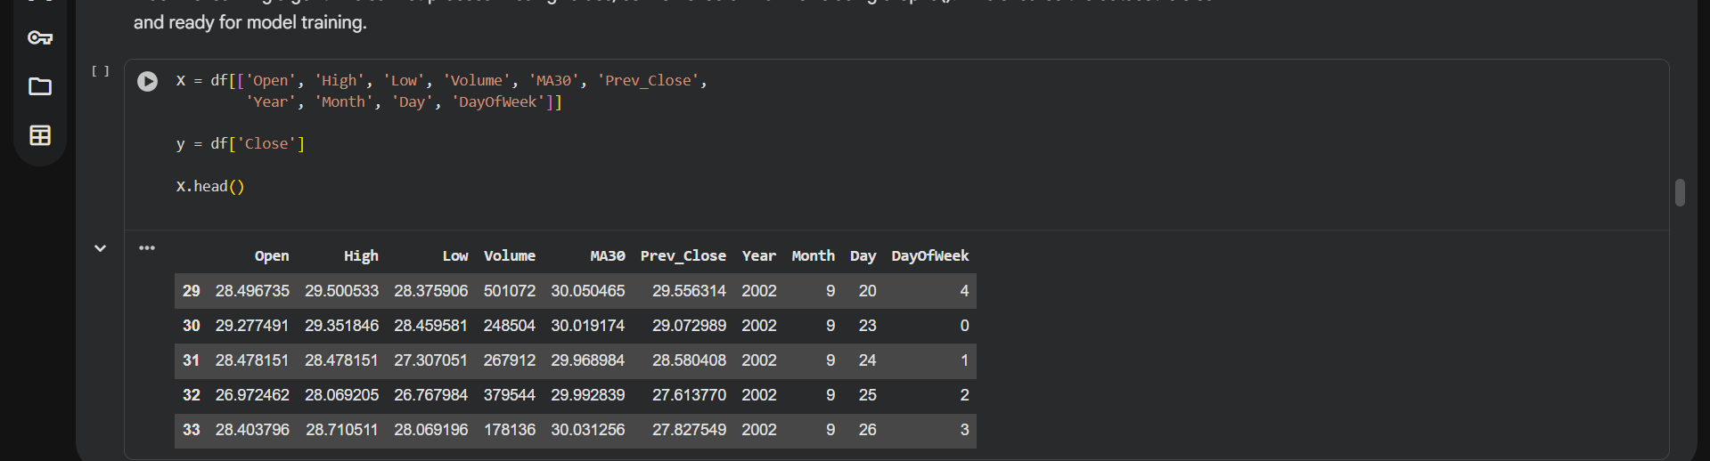
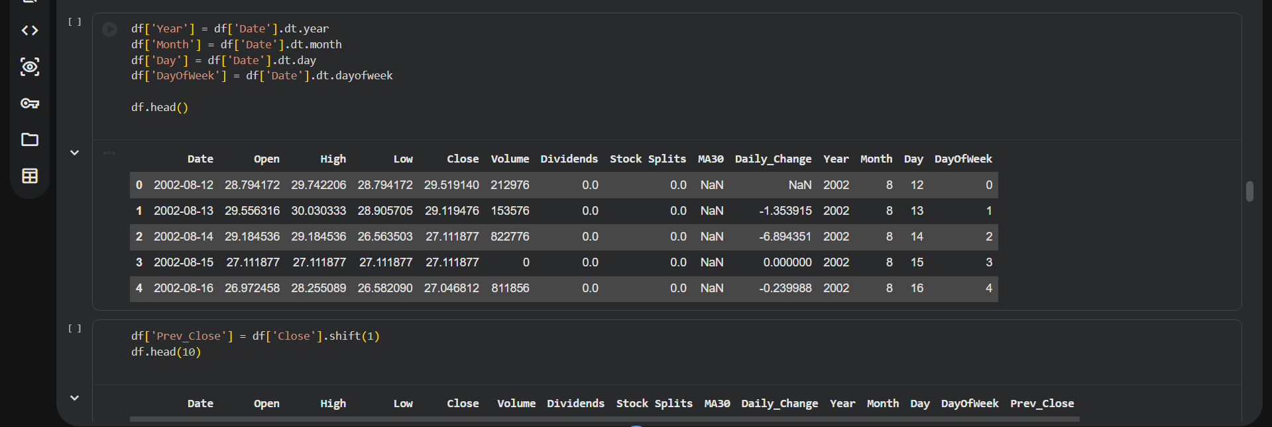

Slide 14
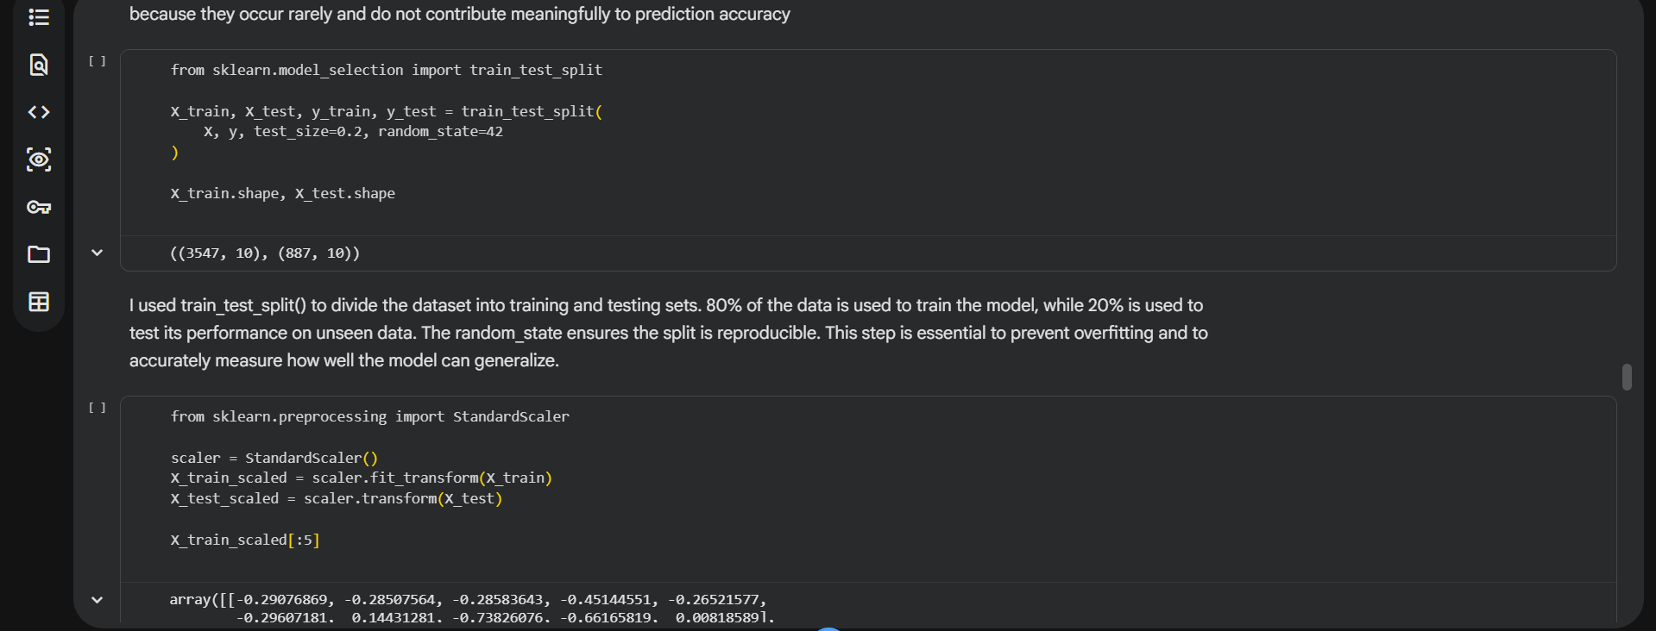
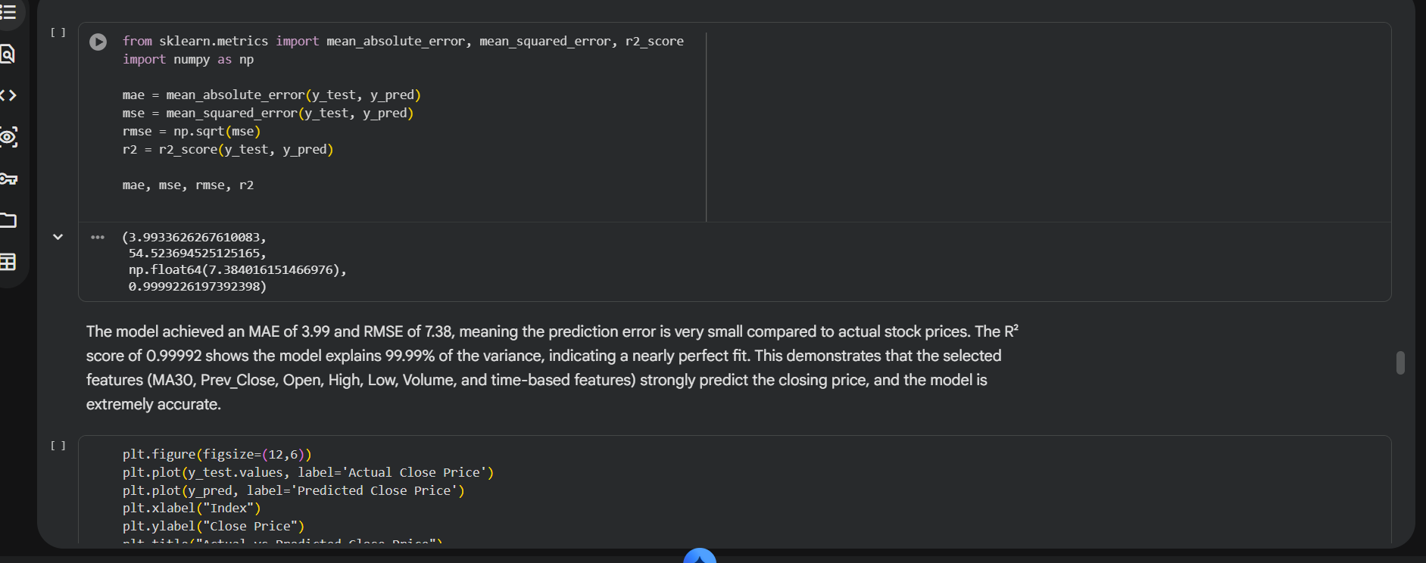

Slide 15
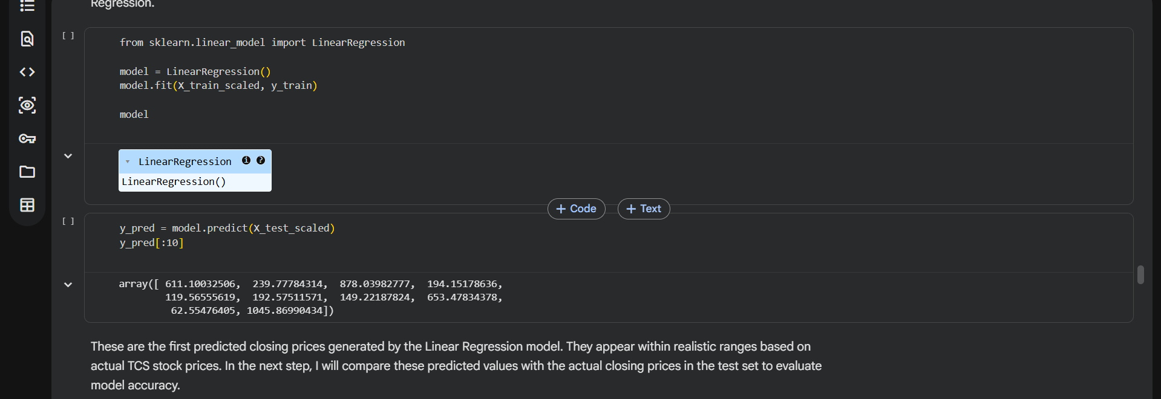
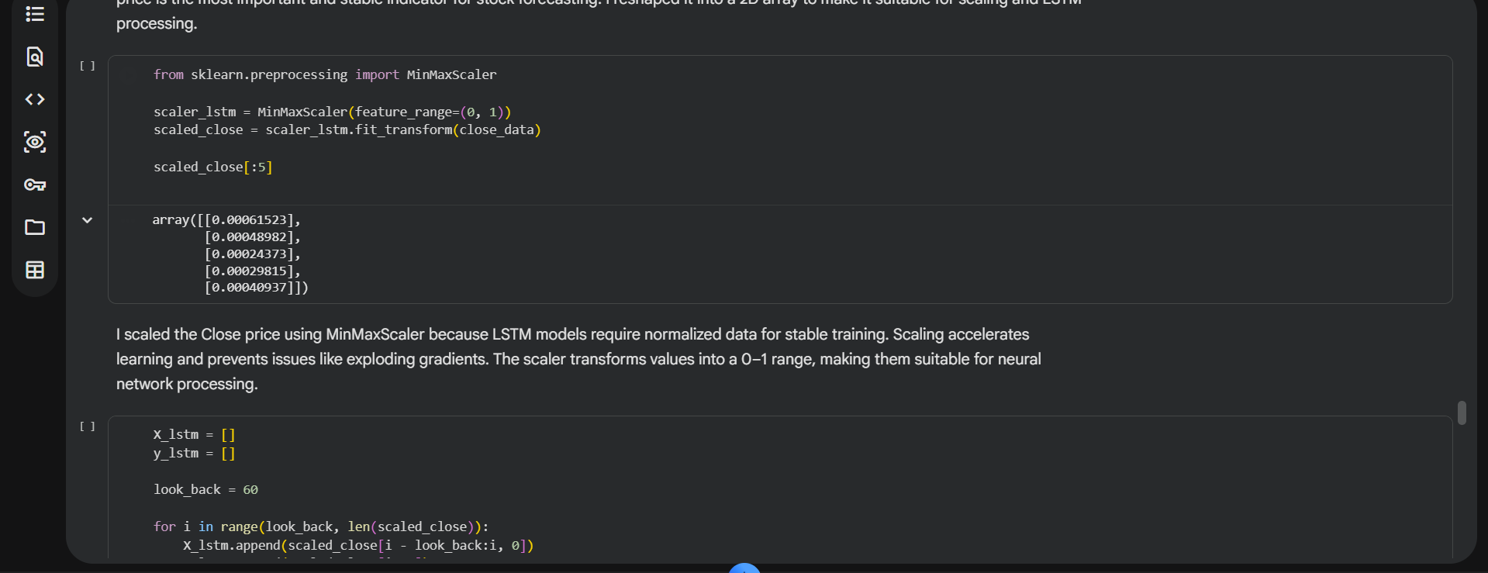

Slide 16
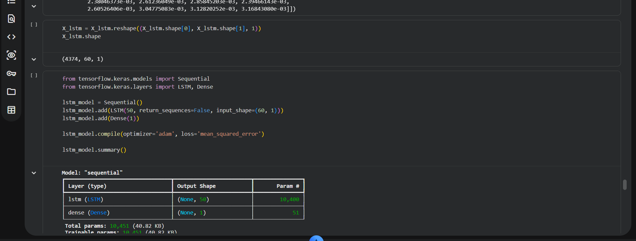
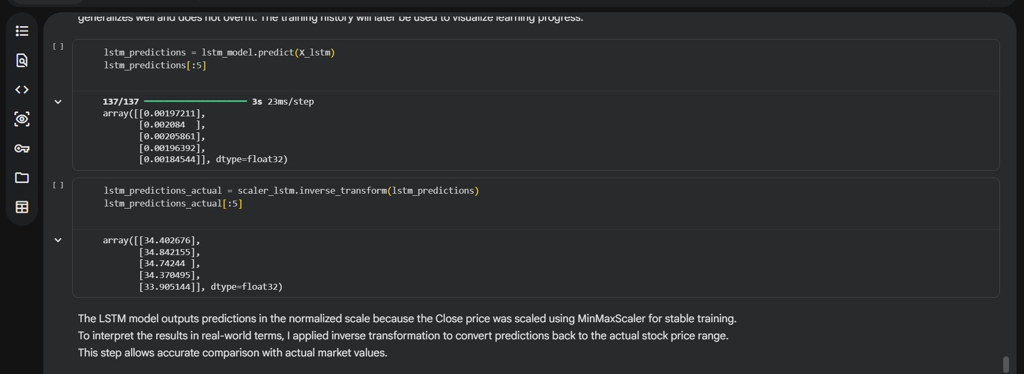

Slide 17
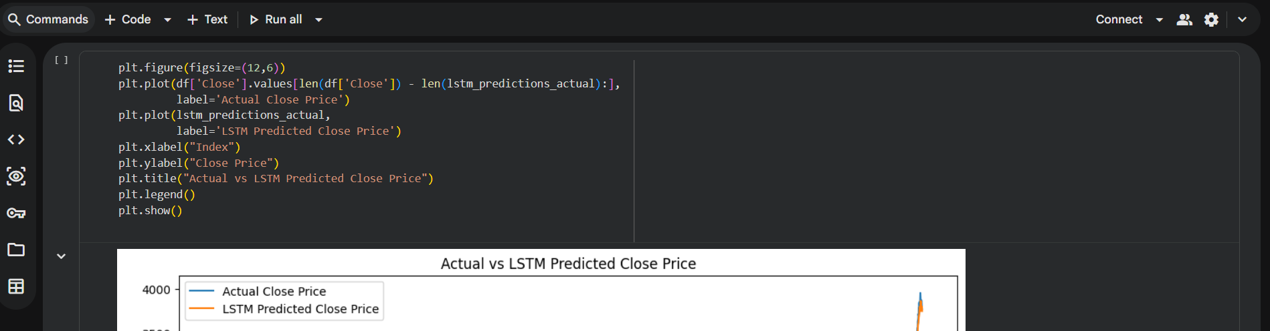
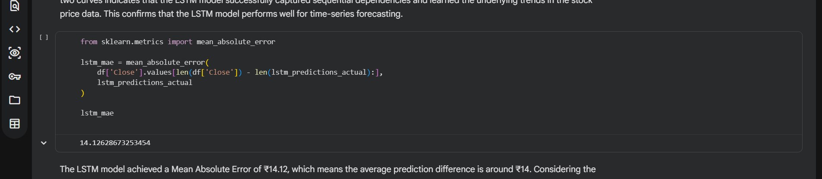

Slide 18
